Slide 1
Classifying
Deepfake and
Real CT-Scans
Yuxuan Mei, Peixuan Liu, Sihoon Yu

Slide 2
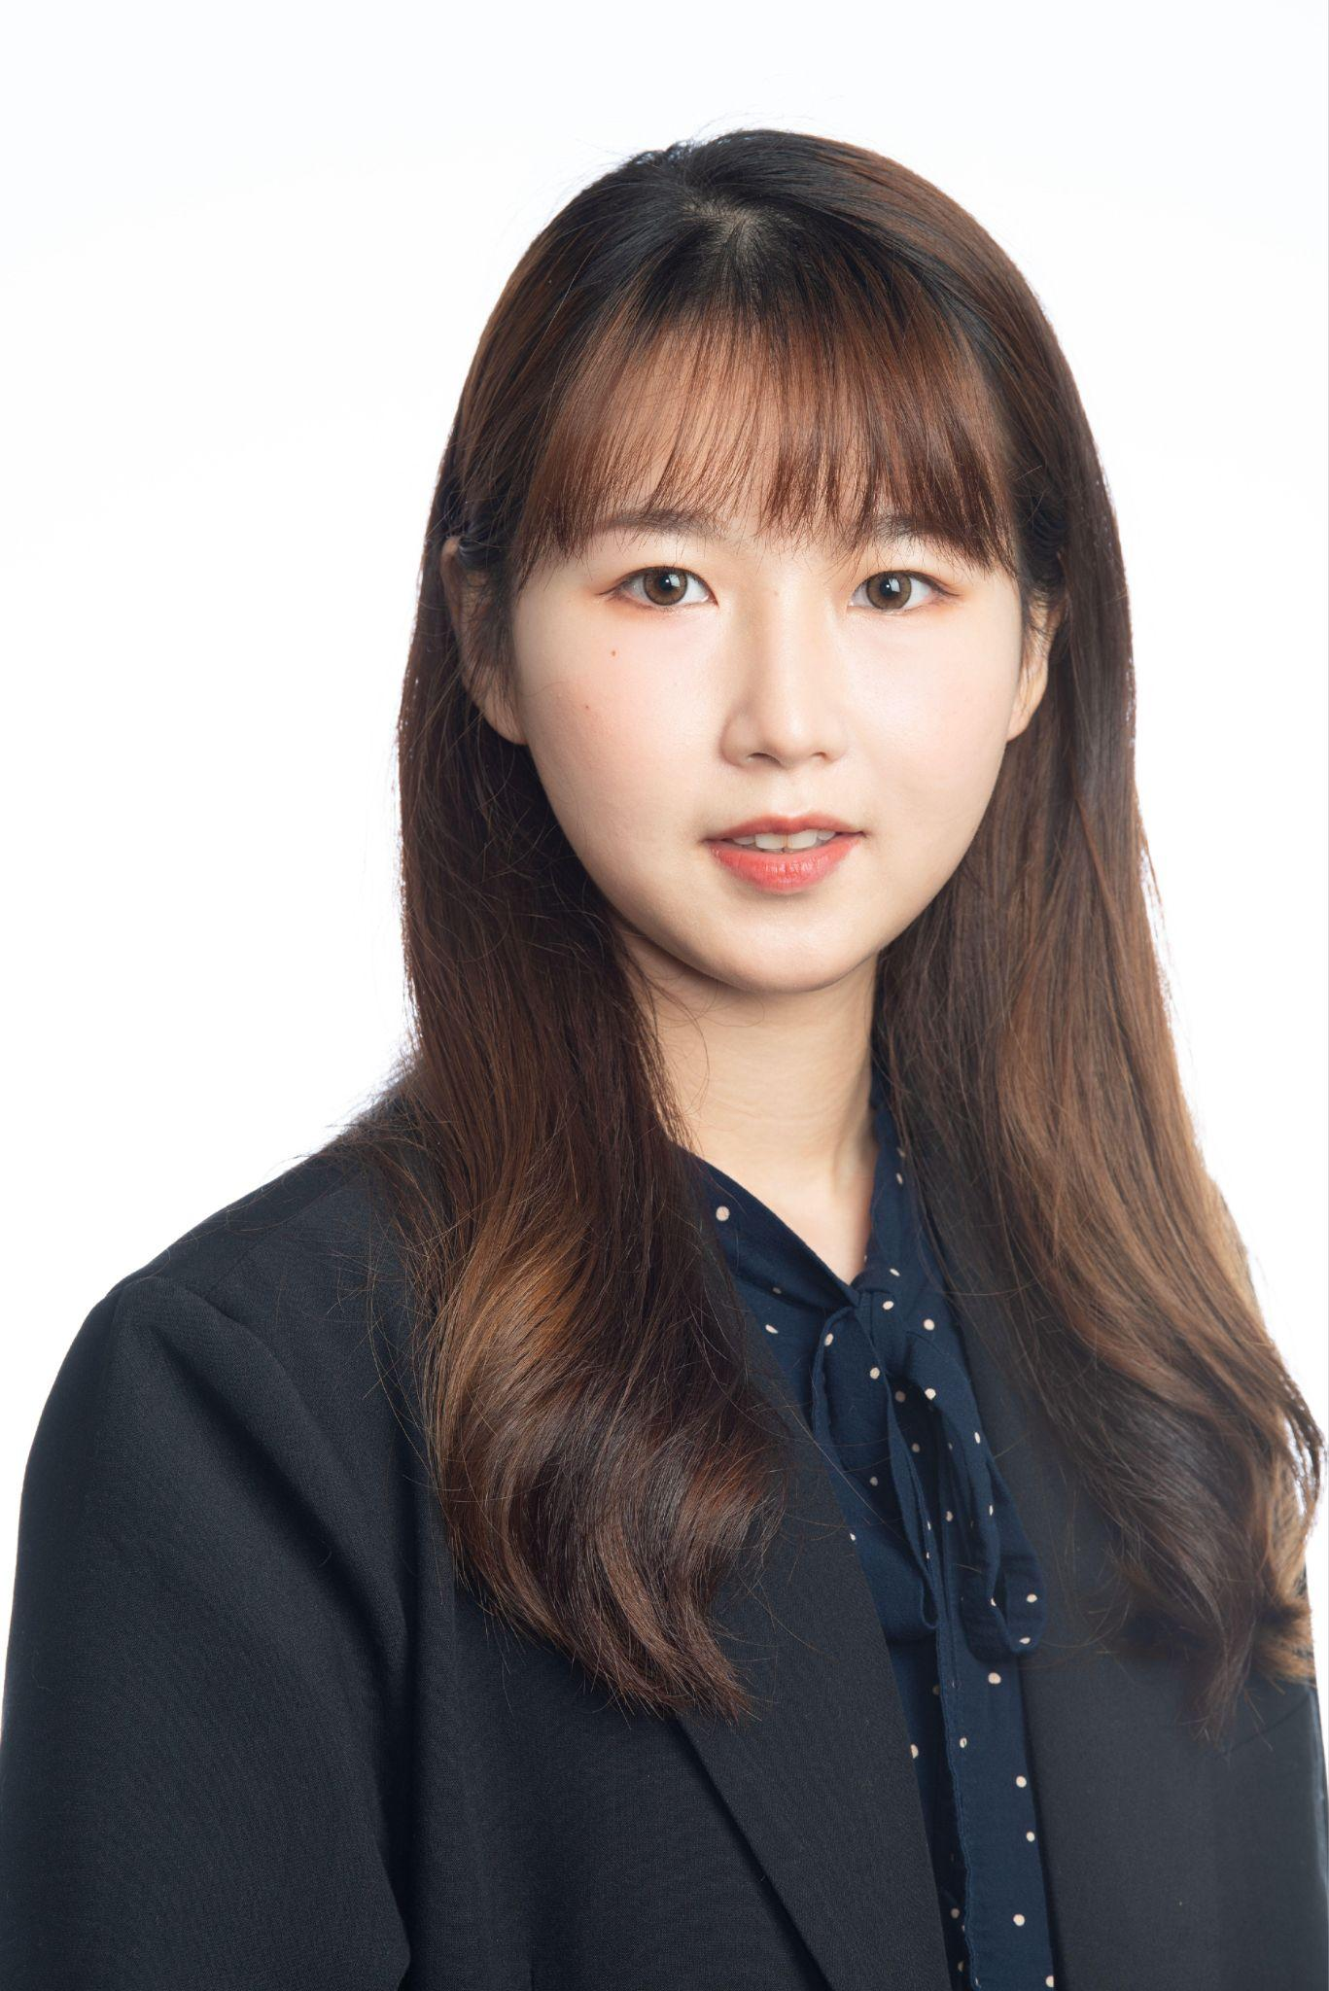
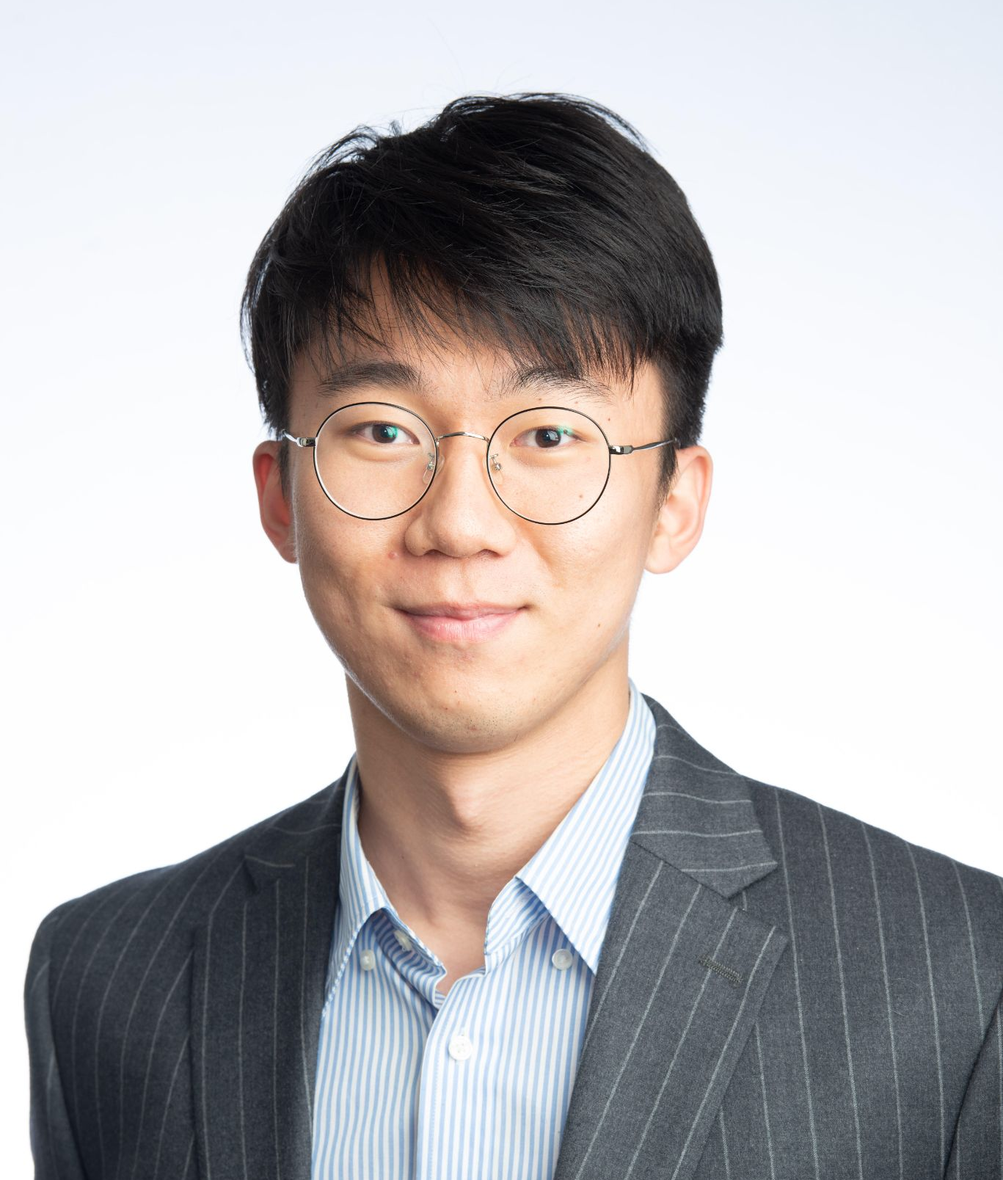
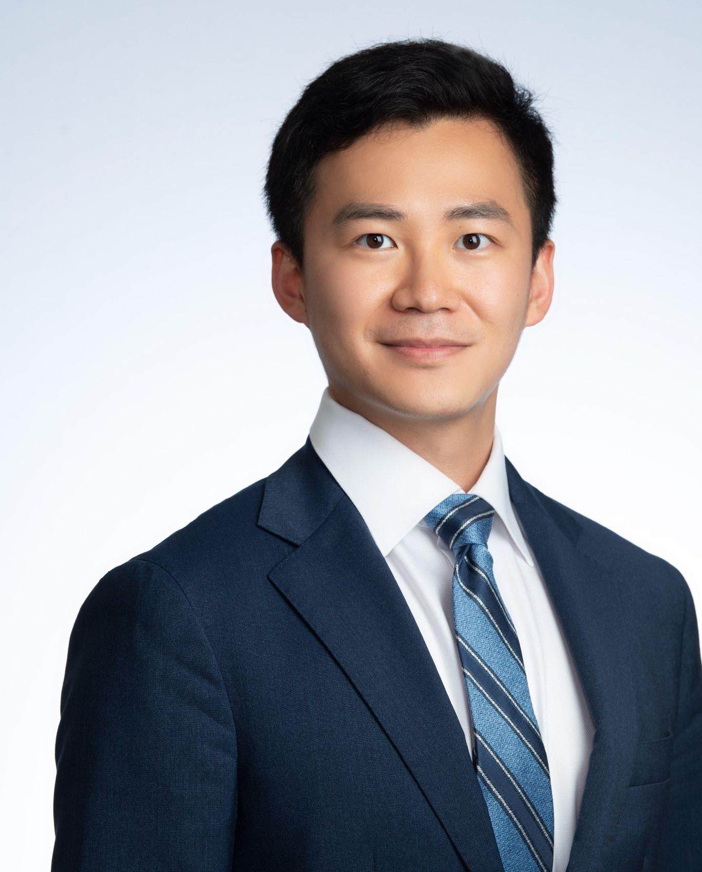
Team Members
Peixuan Liu
Yuxuan Mei
Sihoon Yu

Slide 3

Agenda
01
02
03
Overview
Analysis
Summary

Slide 4
Overview

Slide 5
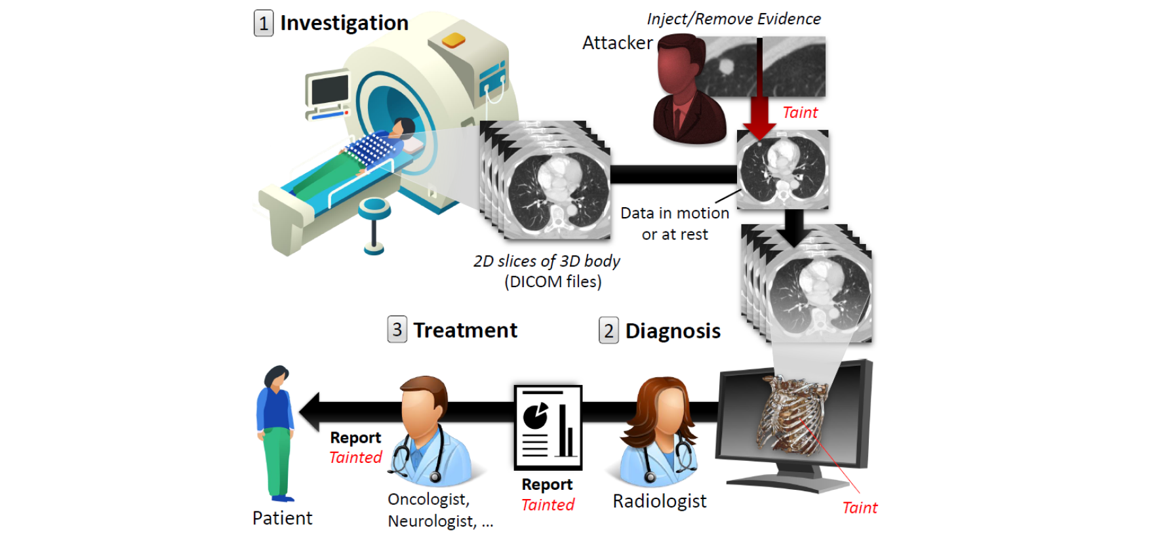
Background and Motivation
Deep learning
Benefit for the healthcare industry to analyze and store medical data
Classifying Fake vs Real
Scans
Deepfakes
Make fake images and videos that are hard to distinguish
Fake scans using GANs
2018 healthcare data breaches, leading to fake medical CT scans

Slide 6
Dataset Introduction
Percentage | Description | Type
35% | Cancer Removed | FB
35% | Cancer Injected | FM
15% | Without Cancer | TB
15% | With Cancer | TM
Source
Big data | Business intelligence | Business analytics
Saturn is the only planet with rings | Mercury is the smallest planet | Earth is where we all live on
Jupiter is the biggest planet | Pluto is now considered a dwarf | Mars is actually a cold place
Neptune is very far from the Sun | Venus is even hotter than Mercury | Mercury is very close to the Sun
UCI Machine Learning Repository
Size
100 scans
23237 slices

Slide 7
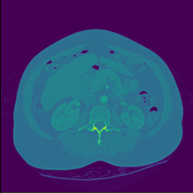
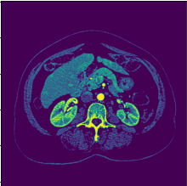
Data Pre-Processing
DCM
PNG

Slide 8
Data Pre-Processing
Original Data
Train / Test
Resize
~23,000 slices
Train ~1400 slices (~85%)
Holdout ~200 slices (~15%)
Image size: (256, 256)
Subset of Data
Transformation using Regex

Slide 9
Analysis & Model

Slide 10
Neural Network Structure
Level 1
Data Augmentation Layer
Random zoom, flip, rotation
Level 2
Conv2D Layers & MaxPooling
Filters: 32, Stride: 2, padding: same
Level 3
Conv2D Layers & MaxPooling
Filters:64, Stride: 2, padding: same
Level 4
GlobalMaxPooling
Global pooling to 1 dimension
Level 5
Dense layer & Dropout
Relu Dense Layer to avoid shrinking too fast
Level 6
Output layer
Softmax Output layer
Notes:
For the analysis, we build our first model from scratch
Augemtnatoin, 2 conv layers, followed by a dense layer
Hyperparameters (didn’t do grid search for the best set of parameters giving computational limitation)
For Conv2d layers: Try different combinations of filters, stride, and number of convolutional layers
For Dense layers: try different number of nodes, activation (sigmoid & relu)
For output layers: use softmax activation (give out probabilities of each outcome class)
categorical cross entropy as the loss function, and tried adam and rmsprop for optimizer
We also tried different epochs and batch sizes, and finalized on a epoch of 25 and batchsize of 16 as the give out the best results

Slide 11
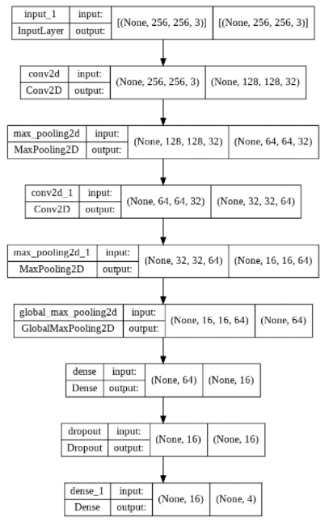
Model Topology
Total Parameters: 20,500
Notes:
Here’s a more detailed topology graph showing our input and output dimensions and parameters. As you can see our model has a total number of parameters around 20k, giving our sample size around 14 hundred, could be a bit complicated and cause overfitting problems

Slide 12
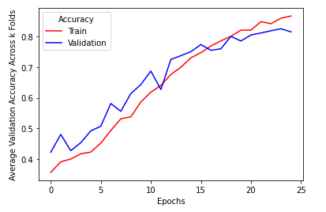
Performance Evaluation
Training dataset | 80%
Holdout dataset | 66%
Informed Radiologist | <35%
Uninformed Radiologist | <10%
Model Accuracy
Average across 5 fold cross validation on training dataset
Notes:
Let’s take a look at our model performance.
On the left it’s the average accuracy across a 5 fold cv on the training dataset, which reached around 80%
We also evaluated this model using a holdout dataset which the model has never seen before, and on this dataset we got an accuracy score of 66%, which suggests a
In comparison, our model is still doing better than radiologist, who’s accuracy was around 35% when they were informed that some scans are fake and 10% when not informed.

Slide 13
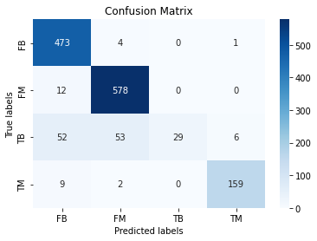
A Deeper dive into the Confusion Matrix
Key Insights
Good precision for FB, FM
Poor recall for TB
Model can’t distinguish TB classes, and is biased towards classifying TB scans as deepfakes
Notes:
Let’s look our model performance in more details in the confusion matrix.
Overall, our model is doing well, as it has good precision for FB,FM
However, it has a poor recall for TB, which suggests our model is having a hard time distinguishing those who really does not have cancer, more specifically, the model is confusing it with FB and FM, as our model think they are deepfake products.

Slide 14
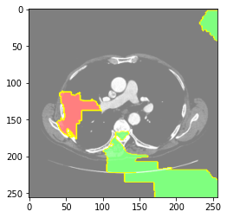
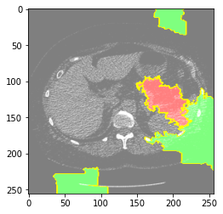
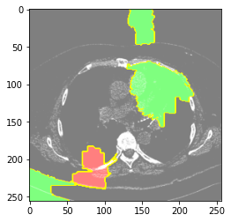
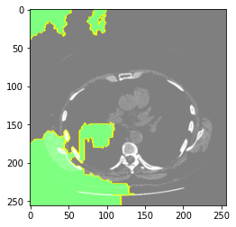
LIME
▼ Probability
▲ Probability

Slide 15
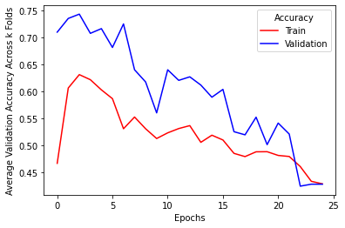
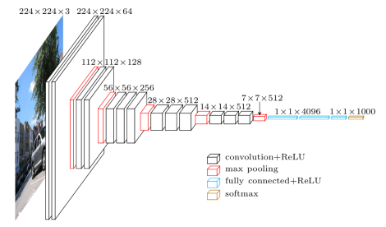
Pre-trained VGG16 Model
Underfitting
Model is not fit for medical images
Alternative
MedNet

Slide 16
Conclusion

Slide 17
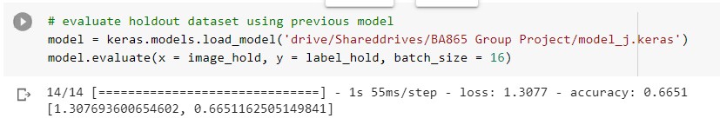
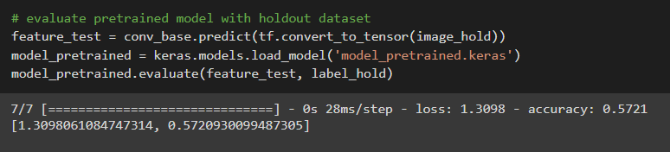
Model Performance
VS
Our Model
VGG16

Slide 18


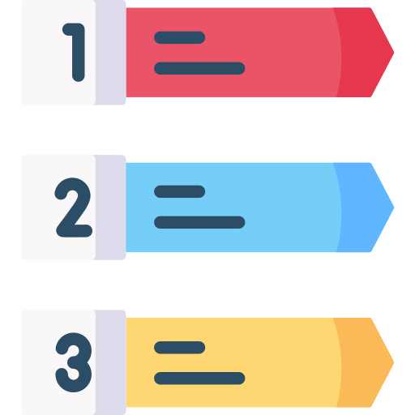

Suggestions
More Data Sample
Extract More Data
From DCM File
Explore 3D ConvNet
Convert DCM files

Slide 19
Thank You

